Slide 1
Generative Language Models and Automated Influence Operations: Emerging Threats and Potential Mitigations

Slide 2

OpenAI CEO on AI risks

Slide 3
Topics to be addressed
What Are Influence Operations, and Why Are They Carried Out?
Influence Operations and Impact
Recent Progress in Generative Models
What Are Generative Models, and How Are They Built?
Access and Diffusion of Generative Models
Generative Models and Influence Operations
Language Models and the ABCs of Disinformation
Expected Developments and Critical Unknowns
Mitigations
Framework for Evaluating Mitigations
Model Design and Construction
Model Access
Content Dissemination
Belief Formation
Language Models Will Likely Change Influence Operations
There Are No Silver Bullet Solutions
Collective Responses Are Needed
Mitigations Must Address Demand As Well As Supply
Further Research Is Necessary

Slide 4
Generative Models:
In the last decade, research in AI has improved the ability to automate the production of digital content, including images, video, audio, and text. These new generative AI models can learn to understand the patterns in a given type of data—like text in the English language or the audio waveforms comprising songs—in order to sample new items of that type and produce original outputs.

Slide 5
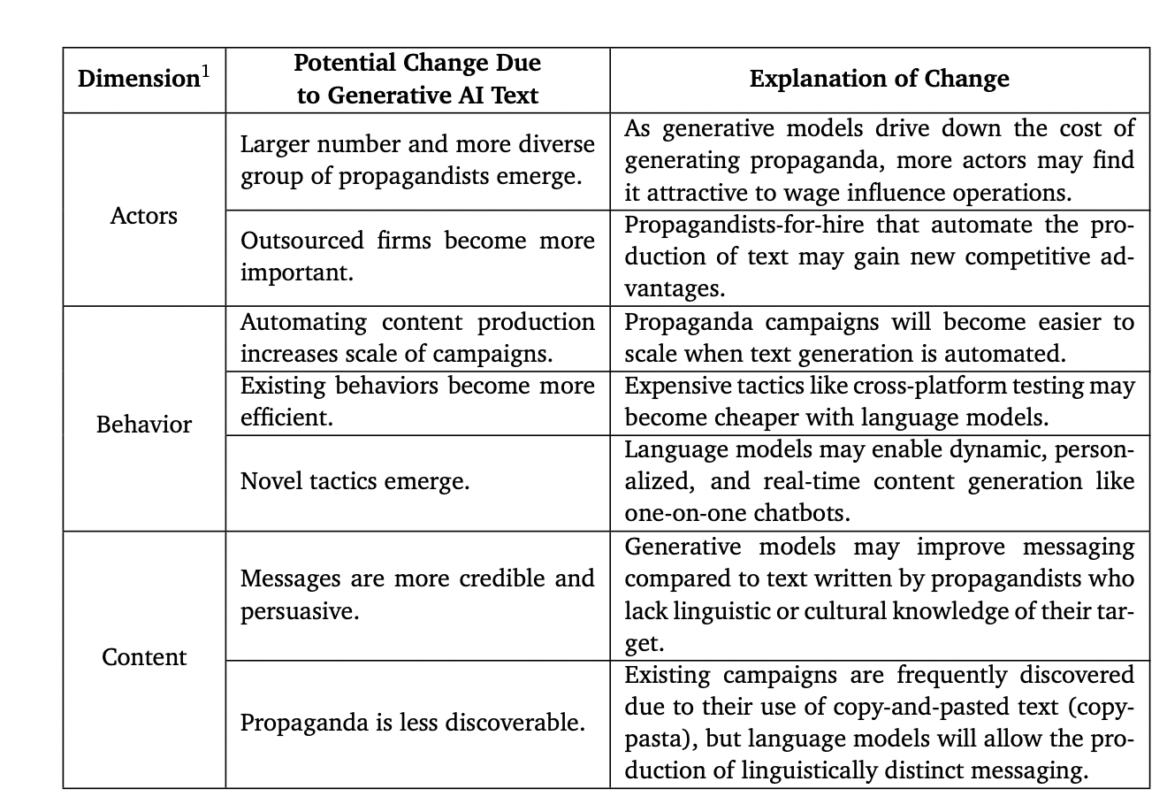

Slide 6
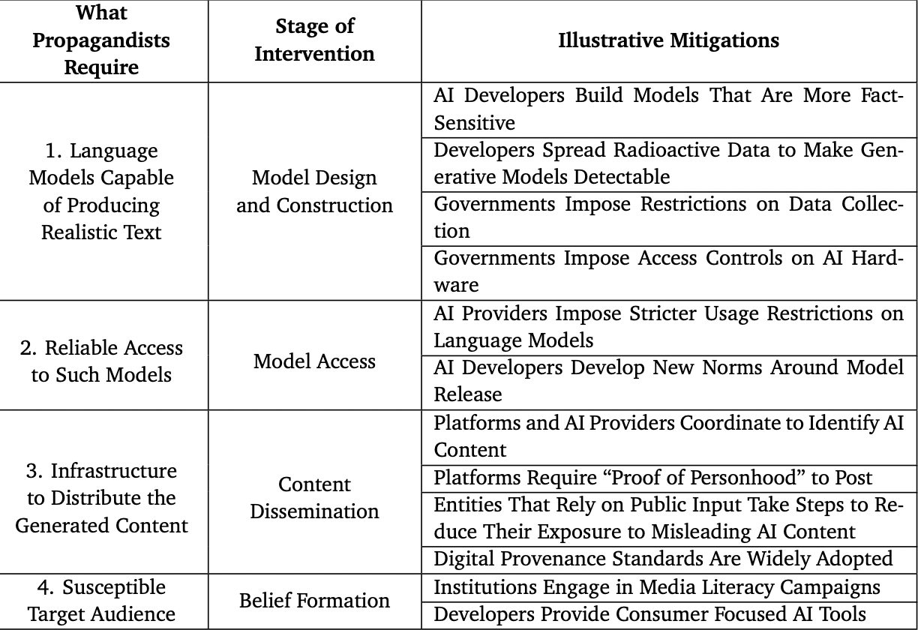

Slide 7
Why Influence Operations?
• Attempts to cast one’s own government, culture, or policies in a positive light • Advocacy for or against specific policies
• Attempts to make allies look good and rivals look bad to third-party countries • Attempts to destabilize foreign relations or domestic affairs in rival countries

Slide 8

Elaborate scene construction and composition with 2022 text-to-image models. While Figure 2 shows that 2022 models can do hard tasks from 2015 easily, text-to-image models can also do tasks that were not possible before. In this image, many details of the scene are described via language, and the system translates that into a plausible image. Left is from Google’s Parti, and right is from Google’s Imagen.

Slide 9
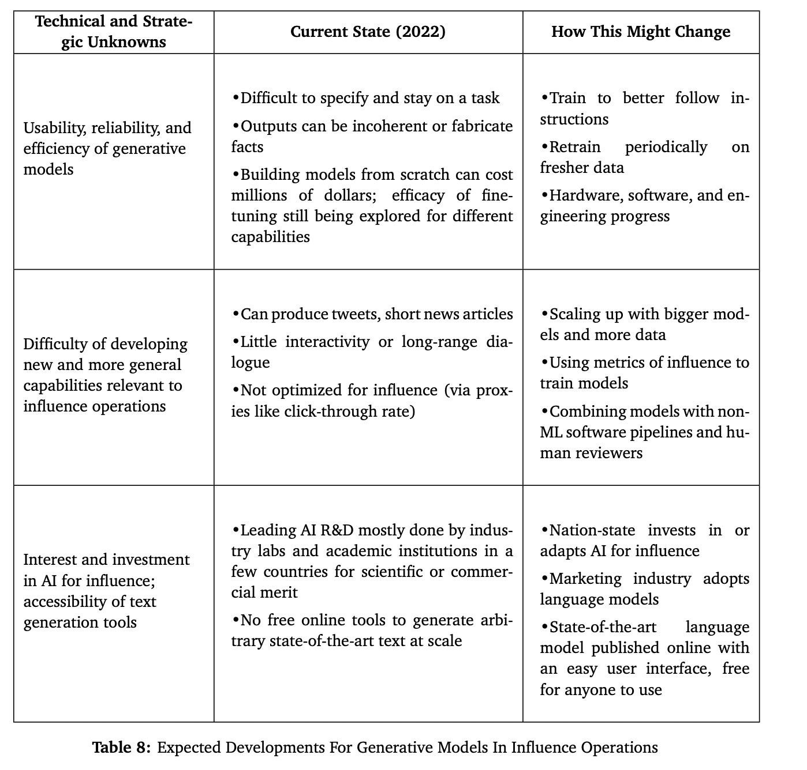

Slide 10
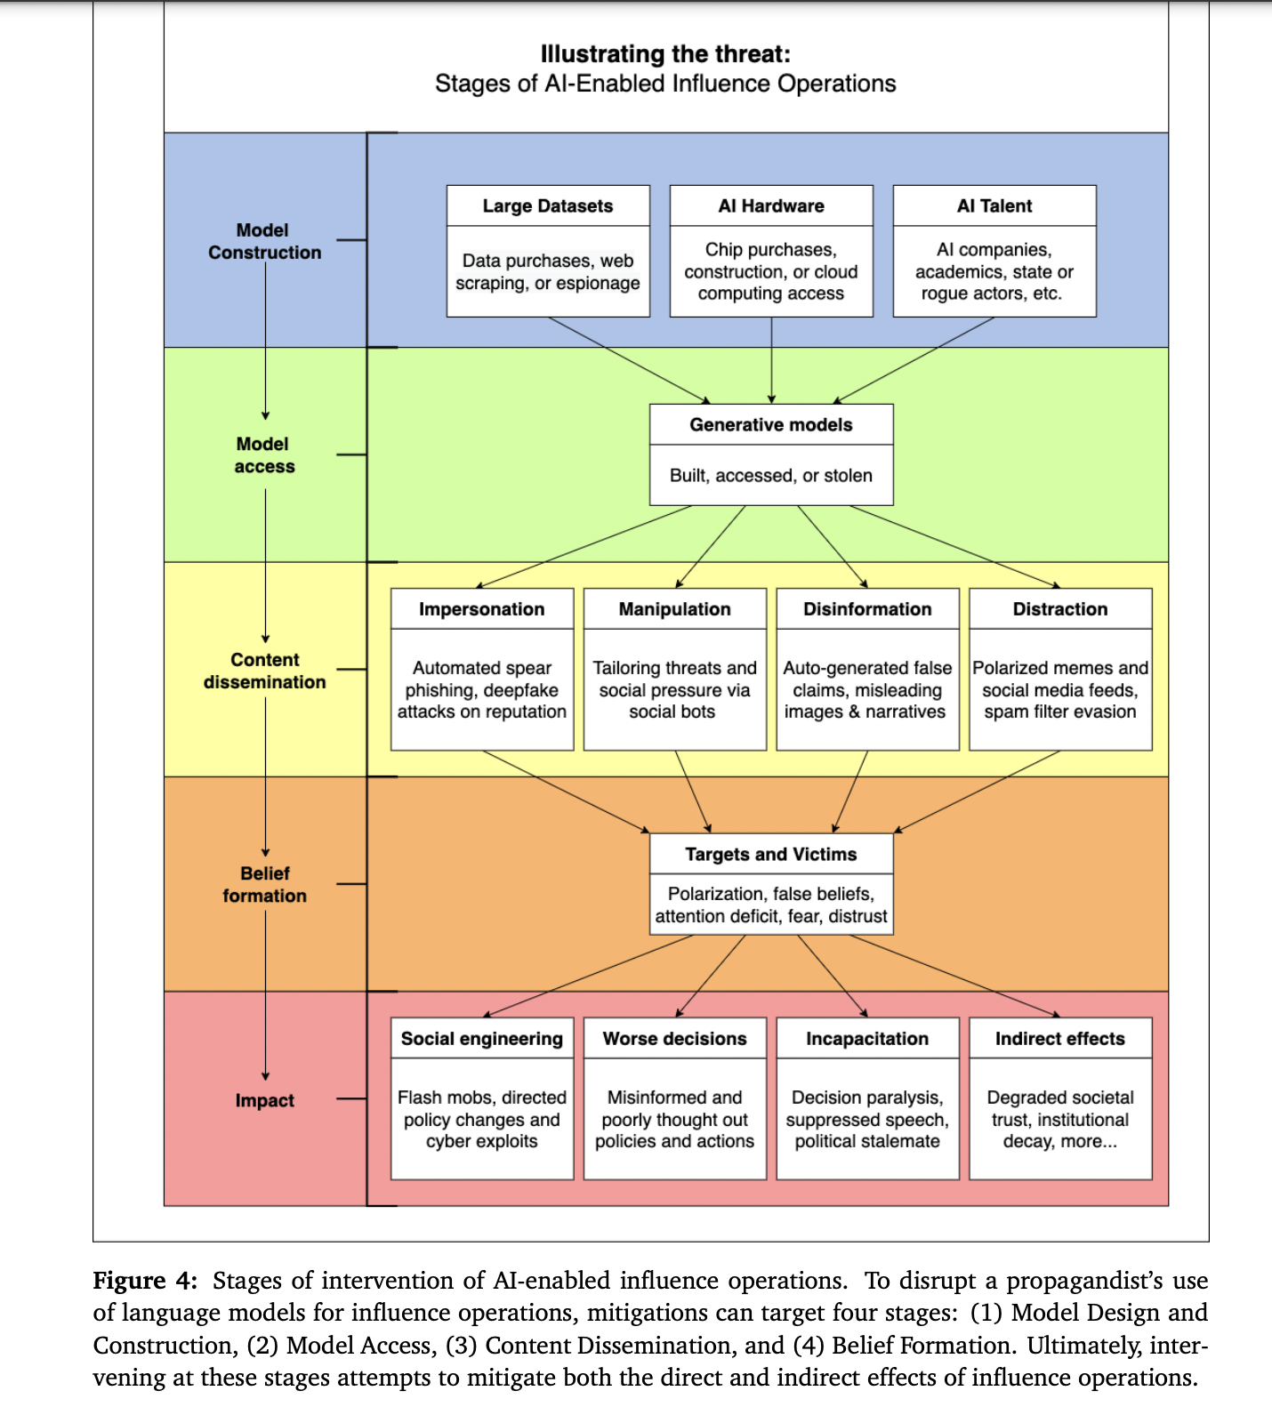

Slide 11
Conclusions
1. Language models are likely to significantly impact the future of influence operations.
2. There are no silver bullets for minimizing the risk of AI-generated disinformation.
3. New institutions and coordination (like collaboration between AI providers and social media platforms) are needed to collectively respond to the threat of (AI-powered) influence operations.
4. Mitigations that address the supply of mis- or disinformation without addressing the demand for it are only partial solutions.
5. More research is needed to fully understand the threat of AI-powered influence operations as well as the feasibility of proposed mitigations

